Slide 1
Statistical Analysis of Barnsley’s Fern : An Application of linear algebra in fractals.
Submitted By : Manuja Chavan & Sukhada Pinjan
Course Name : IMCA 1 (Statistics And Probability )
Department of Mathematics
College Name : Savitribai Phule Pune University
Academic Year : 2025 -2026

Slide 2
Index
Statistical Process Behind Fern
Output Of Barnsley’s Fern
Statistical Analysis Of Barnsley’s Fern
Conclusion And Real Life Application
References
Acknowledgement
Abstract
Introduction
Objective
Importance Of Barnsley’s Fern
Mathematics Representation
Transformation Rule

Slide 3
Acknowledgement
We sincerely thank our respected guide Dr. Ganesh Kadu sir for their continuous support and valuable guidance throughout this project.
We also thank the Department of Mathematics for providing the opportunity to explore the connection between Linear Algebra, Statistics, and Fractals through this project.

Slide 4
Abstract
This project explores the Barnsley’s Fern, a fractal generated through Iterated Function Systems (IFS) using four linear transformations with assigned probabilities.
The fern pattern was created using Python and analyzed statistically through mean, variance, standard deviation, and a Chi-square test.
Results show that the random process aligns with theoretical probabilities, confirming the mathematical consistency of the model.
The study highlights how Linear Algebra and Statistics together can explain complex natural patterns through simple mathematical rules.

Slide 5
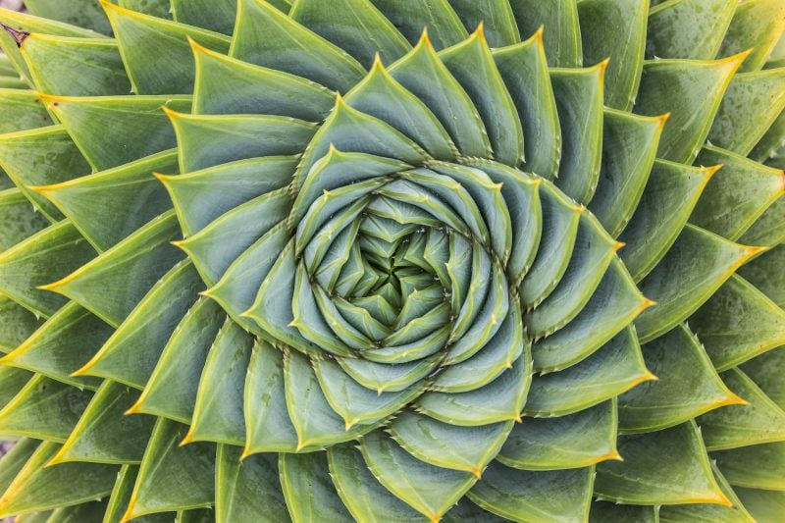
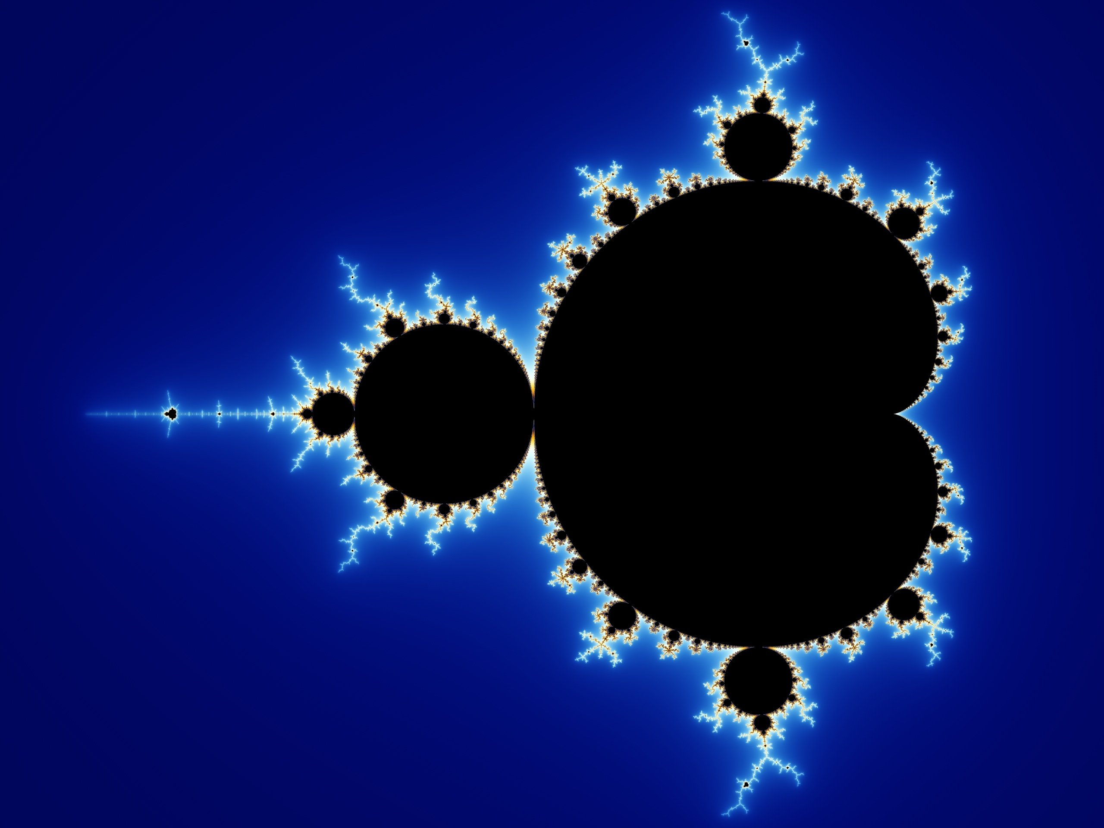
Introduction
What Are Fractals?
Fractals are complex geometric figures that display self-similarity at every scale. They are created through repetitive mathematical transformations and are often used to model natural patterns like trees, ferns, and clouds.
One of the most famous examples of fractals is Barnsley’s Fern, which uses linear algebra transformations to generate a realistic fern-like structure.

Slide 6
Introduction to Barnsley’s Fern :
Barnsley’s Fern, introduced by Michael Barnsley (1988), is created using an Iterated Function System (IFS) four linear equations that repeatedly transform points with scaling, rotation, and translation based on probabilities.
Repeating this process thousands of times forms a fractal resembling a natural fern, linking linear algebra and statistics beautifully..

Slide 7
Objectives
The objective of this project as follows:-
Generate Barnsley’s Fern using linear transformation & (IFS).
Apply the statistical tools to analyse the distribution of generated data points.
To test the randomness of the fern using chi square test.
To summarize the distribution of fractal point using descriptive statistics.
Visualize the Barnsley’s Fern using python programming and interpret the result through statistical analysis.

Slide 8
Importance Of Barnsley’s Fern in Statistics and Mathematics :
Fractal Modelling
Randomness
Nature Simulation
Probability

Slide 9
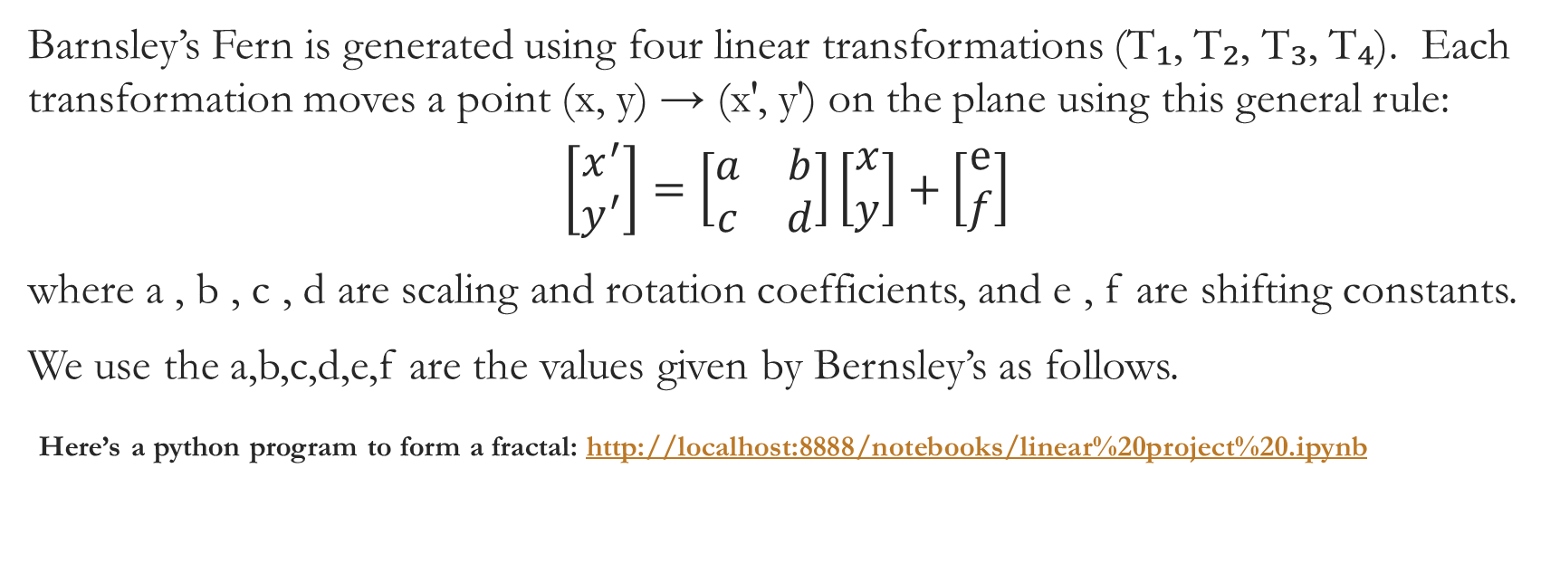
Mathematical Representation of Barnsley’s Fern :
Barnsley’s Fern is generated using four linear transformations (T₁, T₂, T₃, T₄). Each transformation moves a point (x, y) → (x′, y′) on the plane using this general rule:
$$\left[\begin{matrix}x^{′} \\ y^{′}\end{matrix}\right]=\left[\begin{matrix}a & b \\ c & d\end{matrix}\right]\left[\begin{matrix}x \\ y\end{matrix}\right]+\left[\begin{matrix}ⅇ \\ f\end{matrix}\right]$$
where a , b , c , d are scaling and rotation coefficients, and e , f are shifting constants.
We use the a,b,c,d,e,f are the values given by Bernsley’s as follows.
Here’s a python program to form a fractal: http://localhost:8888/notebooks/linear%20project%20.ipynb

Slide 10
Transformation Rules :
Transformation | Equation | Probability
T1(stem) | X’ = 0x + 0y Y’ = 0x + 0.16 y | 0.01
T2(Main Leaflets) | X’ = 0.85x +0.04y Y’ = -0.04x + 0.85y +1.60 | 0.85
T3(Left Leaflets) | X’ = 0.20x - 0.26y Y’ = 0.23x + 0.22y +1.60 | 0.07
T4(Right Leaflets) | X’ = -0.15x + 0.28y Y’ = 0.26x + 0.24y +0.44 | 0.07

Slide 11
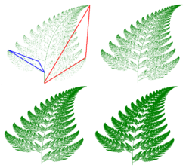
Fractal fern in four states of construction
1. Define Transformation
2) Apply repeatedly
3) Increase Iteration
4) Form Full Fern

Slide 12
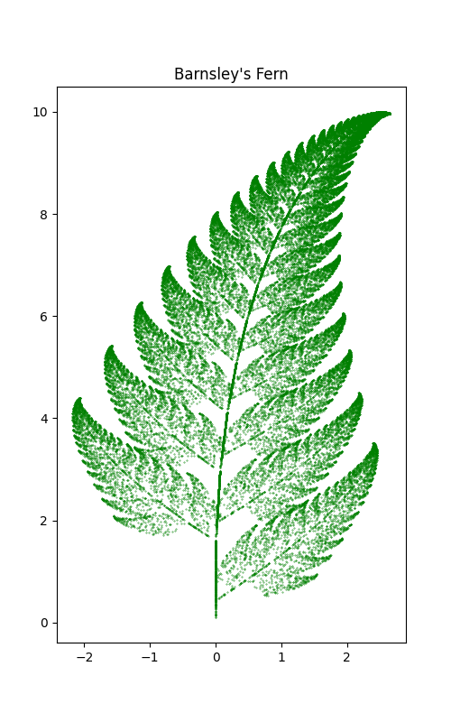
Output Of Barnsley’s Fern :

Slide 13
Statistical Process Behind Fern :
In this project, statistical concepts were used to analyze and understand the numerical patterns generated by Barnsley’s Fern. The process involved the following steps:
Data Generation
Data Collection
Descriptive Statistics
4. Chi-square Test
5. Visualization

Slide 14
Descriptive Statistics Values For X & Y
After generating the Barnsley’s Fern, the x and y coordinates of all points were analyzed statistically.
Measure | X-values | Y-values
Mean | 0.8129 | 6.1937
Variance | 1.4303 | 6.2976
Standard Deviation | 1.19598 | 2.5095
The mean and variance show that the fern’s x-values are tightly clustered, while the y-values are more spread out indicating the fern’s vertical growth pattern.

Slide 15
Chi-Square Test for Transformation Probabilities
Statistics | Values
Observed Frequencies: | [0.01046 , 0.85142 , 0.06852 , 0.0696]
Expected probabilities: | [0.01 , 0.85 , 0.07 , 0.07 ]
Chi square Statistics: | 2.85546
P-value: | 0.4144499
Interpretation: The chi-square test produce a p-value of 0.4144 which is greater than 0.05 so it is a goodness of fit and accurate fern generate.

Slide 16
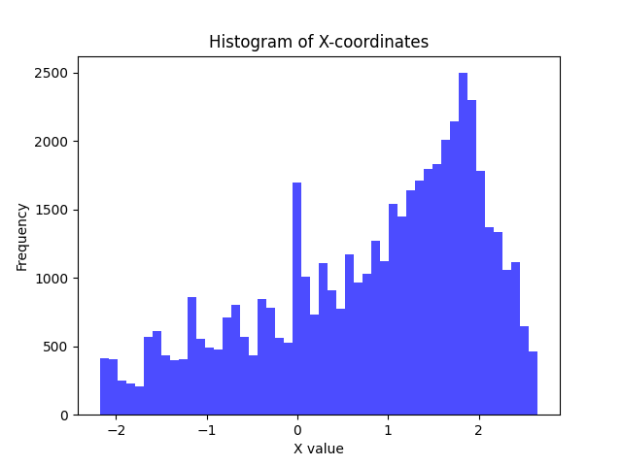
Histogram of X-Coordinate
This Figures shows that how x-values are symmetrically distributed across the fern’s width.

Slide 17
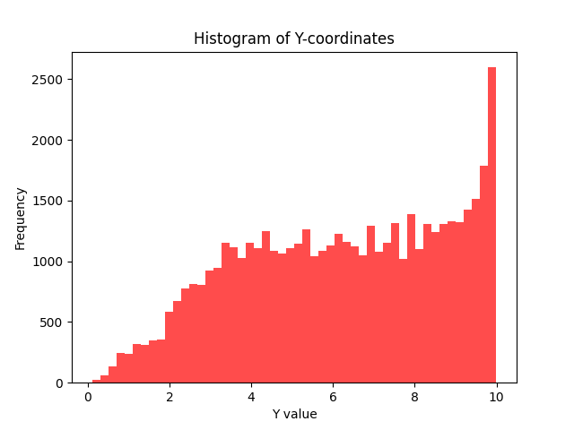
Histogram of Y-Coordinate
This Figure displays the vertical density pattern, highlighting the fern’s height structure.

Slide 18
Conclusion and Real Life Applications
Conclusion:-
Barnsley’s Fern shows how simple math rules create complex natural patterns.
Using Iterated Function Systems (IFS) and probability makes realistic fractals.
Statistical tests confirm predictable structure with small random variations.
The project connects math, statistics, and nature showing order in randomness.

Slide 19
Real-Life Applications:-
Nature Modelling
Computer Graphics & Animation
Data Analysis & Statistics
Mathematical Education

Slide 20
References
Barnsley, M. F. (1988). Fractals Everywhere. Academic Press.
Wikipedia – Barnsley Fern
(https://en.wikipedia.org/wiki/Barnsley_fern)
NumPy, Matplotlib, and Pandas – Python libraries used for data generation and visualization.
Statistical formula references – Applied Statistics and Probability for Engineers (Montgomery & Runger).

Slide 21
Thank you

